Slide 1
What Happens to HIV Programs When Donors Leave? The GFATM procurement cliff
Sharonann Lynch
HIV & TB Policy Advisor
MSF Access Campaign

Slide 2
Chronicle of death foretold:
5 year delay in meeting targets:
+ 2.1 million new HIV infections
+ 1 million AIDS deaths
2017-2030 in 10 HBCs
“There were no new significant commitments from donors in 2017. The recent rise in donor funding is not expected to continue.”
$26 billion
UNAIDS 2018
Notes:
US$11.9 billion announced pledges at the Fifth Replenishment (2017-2019).
“MOST DONORS DECREASED OVERALL FUNDING IN 2017. 8 out of 14 donor governments decreased overall disbursements (Australia, Denmark, Germany, Ireland, Japan, the Netherlands, Norway, and Sweden), although increases by the U.S. and 5 others (Canada, France, Italy, the U.K., and European Commission) more than offset these declines. In currency of origin, the pattern was nearly identical.” (KFF/UNAIDS July 2018 report)

Slide 3
GFATM
2008-2010: USD 9.7 bn
2011-2013: USD 11.7 bn (increase from previous period : 21%)
2014-2016: USD 12.2 bn (increase : 4%)
2017-2019: USD 12.9 bn (increase: 6%)
Notes:
There are a lot of details here, I suggest to present it in bullet points: what are the main gaps, the reliance on donors and absolute lack of fiscal space to increase domestic financing in near to medium term.
[mit]
Restructure according to narrative:
Moz Pepfar and GF for HIV response
But ARV gap 104 mio
PEPFAR & GF might cover (what trigger) but MOH will not
Problems in performance – risk of reduced funding by PEPFAR (for certain implementers)
General problems health funding and no perspective on DMR increase to HIV in current situation – health budget cuts and deficit creating gaps; health systems overall weakened with effect on performance
US: community activities shift to USAID: why?
US gagrule also causing problems in SRH eg tete
[mit] I suggest to add some indication why the gvt cannot be expected to mobilise resources to compensate for gaps:
The overall health financing situation of Mozambique is dire. Due to reduced economic growth and due to suspension of all aid on budget after an ‘illegal loans’ scandal, the health budget is hot by an important reduction and problems in cash flow. As a consequence, severe cuts to the budgets of health district and health facilities have led to lack of running costs for patient food, for transport for patient referrals and drugs, for night shifts and outreach activities. For HIV/TB services to contine more – not less- resources are needed to compensate weakened health systems.
Faced with these shortfalls and limitation of other sources for domestic resource mobilisation, there are now discussions to introduce and increase patient fees as part of the health financing strategy, which wuld further increase access barriers to care – including for HIV services.

Slide 4
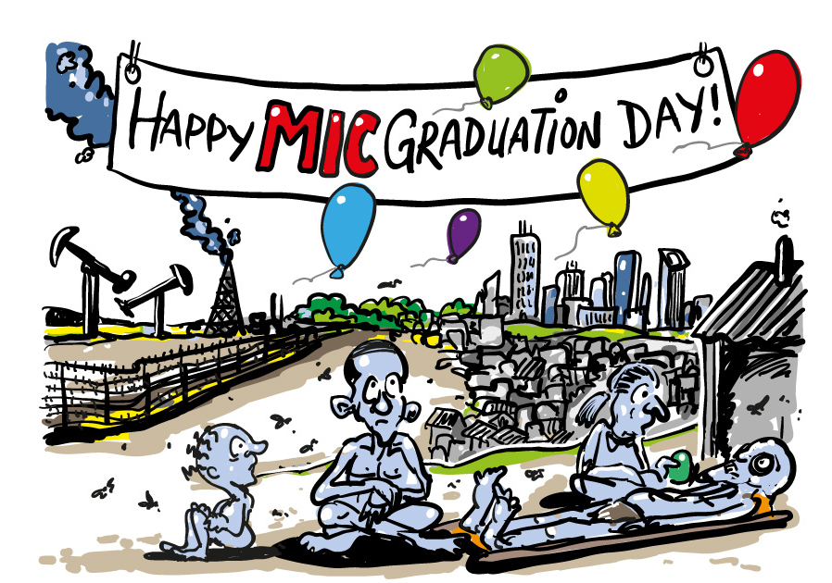

Slide 5
Donor investments guided by crude measures (GNI & disease burden)
Ability to pay
“it’s only a matter of willingness”, despite no or limited assessment of government health financing capacity and fiscal space
Fail to reflect additional factors
Health needs
Epidemiological trends: growing HIV incidence, flat-lined/increased mortality
Needs of key populations
Willingness to pay
Simultaneous transitions outside of HIV (GAVI, etc.)
Notes:
Country transition from donor dependence is something good. However, the how and the when it happens is crucial to not lose gains made and risk placing the burden on people and patients.
Many donors base their investment decisions and when to transition on blunt indicators such as GNI per capita, while there is growing evidence that GNI is not an appropriate measure of a government’s capacity to invest in health (see e.g. Equitable Access Initiative).
Assumptions based on a focus on willingness rather than capacity
Typically, one of the major underlying assumptions is that as countries’ GNI grows, your ability to fund domestically grows, and your need for international assistance decreases. Especially it is assumed the need for grants diminishes and international loans can take the place of grants.
The GNI evolution is seen as linear, without fallback- which is often not the reality. Several countries do a jojo movement, with GNI per capita fluctuating just above or below the threshold and changing category.
NB: The Equitable Access Initiative headed by GF concluded that GNI per capita is an imperfect proxy for understanding health need or a government’s capacity to invest in health. It can be a reliable starting point for assessing the average level of wealth or general economic capacity in a context.
https://www.theglobalfund.org/en/archive/equitable-access-initiative/

Slide 6
Donor investments guided by crude measures (GNI & disease burden)
Negative knock-on effects
GFATM eligibility defines scope of licensing deals to the MPP, eligibility for access prices, etc.
Reality check →
New MICs: Kenya-Bangladesh, Myanmar- Congo Brazzaville- Mauretania- Nigeria
LICs (e.g in WCA) facing decrease of donor funding
Premature transitions undermine hard-won gains & result in health care gaps
Notes:
Country transition from donor dependence is something good. However, the how and the when it happens is crucial to not lose gains made and risk placing the burden on people and patients.
Many donors base their investment decisions and when to transition on blunt indicators such as GNI per capita, while there is growing evidence that GNI is not an appropriate measure of a government’s capacity to invest in health (see e.g. Equitable Access Initiative).
Assumptions based on a focus on willingness rather than capacity
Typically, one of the major underlying assumptions is that as countries’ GNI grows, your ability to fund domestically grows, and your need for international assistance decreases. Especially it is assumed the need for grants diminishes and international loans can take the place of grants.
The GNI evolution is seen as linear, without fallback- which is often not the reality. Several countries do a jojo movement, with GNI per capita fluctuating just above or below the threshold and changing category.
NB: The Equitable Access Initiative headed by GF concluded that GNI per capita is an imperfect proxy for understanding health need or a government’s capacity to invest in health. It can be a reliable starting point for assessing the average level of wealth or general economic capacity in a context.
https://www.theglobalfund.org/en/archive/equitable-access-initiative/

Slide 7
What falls away
Services for key populations
80% of new HIV infections outside of SSA
We still need ring-fenced funding to ENCOURAGE governments to do the right thing
Peer-run services for key populations
Community-based services and support
Outreach and adherence support

Slide 8
What falls away
KERSTIN, WHAT DO YOU WANT ME TO DO – REMOVE THIS SLIDE ENTIRELY?
5.7 mn
8.2 mn
9.4 mn
ART initiation counselling
Tracing, enhanced adherence counselling
Peer outreach, HTC
Alternative refill models
UNAIDS 2018
Notes:
Gaps in cascade – have prompted s to identify effecties strategies to adress these gaps
Such as decentralisation, task shifting, integration of HIV services, longer drug refills
But patient education and counselling have also shown to be effective strategies to adress these gaps
--
We’re not done innovating, consolidation. … AIDS COMPETENT SOCIETY
--
Cmty / peer services
Cmty advocacy and monitoring

Slide 9
Co-financing of commodities
The Global Fund (GFATM) Sustainability, Transitions and Co-Financing policy co-financing requirements apply to ALL countries:
progressive and general increase in government expenditure on health;
b) increased co-financing (uptake) of GFATM supported programs, focusing on recurrent costs of key program components, including “recurrent human resource associated costs, procurement of essential drugs and commodities for the three diseases, and rights based programs for key and vulnerable populations, which are in line with epidemiological context and informed by evidence as appropriate”
[Of course, governments have been procuring some drugs themselves – especially for TB]

Slide 10
16-18 years of building healthy markets
GFATM benefits
PRICE
Competition, suppliers
Large volumes
HIV + TB + HCV
ARVs TLD
QUALITY
WHO Prequalification Project
HCV DAAs
Stringent Drug Regulatory Authority (SDRA)
DRTB drugs
REGULATORY
Import waivers
SUPPLY
Multiple suppliers
Molecular testing
VL HIV, HV HCV, MTB/RIF
Forecasting

Slide 11
West and Central Africa
Guinea
WCA Context
Government procurement of 1st line ARVs
9,000 in 2018
14,00 by end 2020
Acute supply difficulties in May-July
No Transition Readiness Assessment (TRA)
40% ART coverage
30% drop in GFATM funds (vs 2015-2017)
Co-financing: governments pressed to procure ARVs e.g. Guinea, Sierra Leone
Notes:
30% drop in GFATM funds (compared to grants 2015-17
PLHIV: 120 000
ART coverage: 35% (adults) 18% (kids)
COE; HDI: 183/187
GF HIV allocation: USD 41 m
Weak supply systems, “limited visibility of orders”
PLHIV: 120 000
ART coverage: 35% (adults) 18% (kids)
COE; HDI: 183/187
GF HIV allocation: USD 41 m
Weak supply systems, “limited visibility of orders”
PLHIV: 120 000
ART coverage: 35% (adults) 18% (kids)
COE; HDI: 183/187
GF HIV allocation: USD 41 m
Weak supply systems, “limited visibility of orders”
---
•GFs assessment: The GAC report on the 2018-20 grant highlights ”limited visiblity of orders” by the government, pointing to shortfalls in the 2014-16 period. Solution identified: request detailed list of products orders to enable quantification and visibility, as well as advocacy and national health accounts reporting.
•Documented PSM weaknesses: According to the OIG report August 2017, supply chain problems include:
- Limited reliable data affecting quantification of medicines
- Inadequate inventory management systems.
- Potential loss of quality of medicines due to weak storage practices

Slide 12
East Europe and Central Asia
40% GFATM reductions from the previous allocation period
HIV incidence doubled since 2000
No reduction in HIV/AIDS deaths since 2010
Highest prevalence of MDR-TB (9 of 16 MDR-TB HBCs)
Armenia:
Failed tender…
Shortage of 1st line TB
Notes:
30% drop in GFATM funds (compared to grants 2015-17
PLHIV: 120 000
ART coverage: 35% (adults) 18% (kids)
COE; HDI: 183/187
GF HIV allocation: USD 41 m
Weak supply systems, “limited visibility of orders”
PLHIV: 120 000
ART coverage: 35% (adults) 18% (kids)
COE; HDI: 183/187
GF HIV allocation: USD 41 m
Weak supply systems, “limited visibility of orders”
PLHIV: 120 000
ART coverage: 35% (adults) 18% (kids)
COE; HDI: 183/187
GF HIV allocation: USD 41 m
Weak supply systems, “limited visibility of orders”
---
•GFs assessment: The GAC report on the 2018-20 grant highlights ”limited visiblity of orders” by the government, pointing to shortfalls in the 2014-16 period. Solution identified: request detailed list of products orders to enable quantification and visibility, as well as advocacy and national health accounts reporting.
•Documented PSM weaknesses: According to the OIG report August 2017, supply chain problems include:
- Limited reliable data affecting quantification of medicines
- Inadequate inventory management systems.
- Potential loss of quality of medicines due to weak storage practices

Slide 13
16-18 years of building healthy markets
GFATM benefits
PRICE
Competition, suppliers
Kazakhstan: Xpert >%50
Large volumes
Where next?
QUALITY
WHO Prequalification Project
Philippines: PAEDS TB drugs
Stringent Drug Regulatory Authority (SDRA)
India: PAEDS ARVs
REGULATORY
Import waivers
Armenia: TB drugs
SUPPLY
Multiple suppliers
Guinea: ARVs
Forecasting
Notes:
Now, go fowrad, countries trans and not are switcing to NATL PROCUREMENT.
Our fear
OUR FEAR - at the moment when best tools.- rapid molecular multi-disease platforms,
science being stopped at the border, ju

Slide 14
What the Global Fund should do
Look before you leap
Transition readiness assessments, but what about co-financing?
Act up on the readiness assessments
Co-financing agreements
Transition timelines
Readiness assessments
Even small amounts allow countries to access GFATM markets (GDF, PPM)
ART scale-up, LTFU, RIPS, HIV incidence should be performance/ ”success” indicators
Provide transparency
Provide bridge funding
Monitor & report

Slide 15
What governments need to do
PRICE
Competition, suppliers
Use GLOBAL MARKETS
vs. national bids
Large volumes
Transparent bids, process
QUALITY
WHO Prequalification Project
Require
WHO PQ/SDRA
Stringent Drug Regulatory Authority (SDRA)
REGULATORY
Import waivers
Enrol in WHO Collaborative Registration Procedure
Reduce regulatory barriers
SUPPLY
Multiple suppliers
Strengthen PSM
Forecasting
Strengthen forecasting
Notes:
Now, go fowrad, countries trans and not are switcing to NATL PROCUREMENT.
Our fear
OUR FEAR - at the moment when best tools.- rapid molecular multi-disease platforms,
science being stopped at the border, ju

Slide 16
PRICE
Use GLOBAL MARKETS
vs. national bids
←SUPPORT CS advocacy & watchdog role
Transparent bids, process
←SUPPORT pooled procurement/negotiation
←INCENTIVISE
policy changes
QUALITY
Require
WHO PQ/SDRA
←INCENTIVISE
companies to apply
REGULATORY
Enrol in WHO Collaborative Registration Procedure
←INCENTIVISE
policy changes
Reduce regulatory barriers
UNITAID,
ou et vous?
SUPPLY
Strengthen PSM
Strengthen forecasting
Notes:
Now, go fowrad, countries trans and not are switcing to NATL PROCUREMENT.
Our fear
OUR FEAR - at the moment when best tools.- rapid molecular multi-disease platforms,
science being stopped at the border, ju

Slide 17
Summary
Robust health financing, fiscal space analysis needed to ensure realistic domestic resource mobilization projections
We need urgent mitigation of risks BUT ALSO question the when, the how, and the what is being transitioned
Critical to safeguard innovation, integration, consolidation of gains made
Increased domestic funding should be additional to what donors CURRENTLY provide
Notes:
we’re still in the moment
Stop normalizing GFATM/donors leaving without looking
Will new tools/science be stopped at the border?
innovation, integration, consolidations

Slide 18
Thank you
For latest MSF reports, go to:
www.msf.org/aids-2018
sharonann.lynch@msf.org
Acknowledgements:
MSF Field Teams
Kerstin Akerfeldt
Mit Philips
Amanda Banda
Tom Ellman
Christophe Perrin
Jess Burry

Slide 19
Mozambique
No MoH contribution to ARVs. ARVs gap not budgeted for US$104m though assurance by both GF and PEPFAR it will be covered “if need arises”
Concern regarding the imminent risk of withdrawal of funds in case the country does not show good outcomes. Do more with less”- not completely acknowledged by all. However, the competitive environment among implementing partners, focused in efficiency and performance indicators. Some implementing partners or CSOs have stopped some activities and others saw their budget being drastically cut.
The activities focusing key pops also suffered consequences. It was decided that all the community activities will be covered by USAID, through FHI360, differing from before when CDC and USAID shared the activities
Mexico City Policy had already a devastating impact on SRH activities with international and local NGOs having funding cuts, especially regarding ToP and interventions focused on key pops and woman in general. ICRH, a SRH NGO based in Tete province
Notes:
There are a lot of details here, I suggest to present it in bullet points: what are the main gaps, the reliance on donors and absolute lack of fiscal space to increase domestic financing in near to medium term.
[mit]
Restructure according to narrative:
Moz Pepfar and GF for HIV response
But ARV gap 104 mio
PEPFAR & GF might cover (what trigger) but MOH will not
Problems in performance – risk of reduced funding by PEPFAR (for certain implementers)
General problems health funding and no perspective on DMR increase to HIV in current situation – health budget cuts and deficit creating gaps; health systems overall weakened with effect on performance
US: community activities shift to USAID: why?
US gagrule also causing problems in SRH eg tete
[mit] I suggest to add some indication why the gvt cannot be expected to mobilise resources to compensate for gaps:
The overall health financing situation of Mozambique is dire. Due to reduced economic growth and due to suspension of all aid on budget after an ‘illegal loans’ scandal, the health budget is hot by an important reduction and problems in cash flow. As a consequence, severe cuts to the budgets of health district and health facilities have led to lack of running costs for patient food, for transport for patient referrals and drugs, for night shifts and outreach activities. For HIV/TB services to contine more – not less- resources are needed to compensate weakened health systems.
Faced with these shortfalls and limitation of other sources for domestic resource mobilisation, there are now discussions to introduce and increase patient fees as part of the health financing strategy, which wuld further increase access barriers to care – including for HIV services.

Slide 20
Constrained Global Fund allocations
Despite increase in allocation for highest burden countries, the amounts available are not coresponding to pace of scale up – leading to larger shares used for commodities (70% in Zimbabwe, 63% in Kenya, 69% in Mozambique)
Funding request outside the allocated envelopes for essential interventions, awaiting available funding
Key pills of HIV response
Further scale-up of ARV treatment
Adherence support
Strengthening PSM, HRH, HIV testing & key population activities
Stagnating funding increases pressure on accelerated domestic resource mobilisation, but international funding continues to be crucial to achieve epidemic control .
Notes:
Main message: in high burden countries, funding shortfalls lead to distorted balance in grants to ensure comprehensive programming, since lifesaving treatment has to be prioritised. (CAUTION: some argue that balance in grants is more important than continued initiation- bringing back treatment vs prevention arguments). And even when minimum treatment costs have been secured – the needed level of treatment costs do not fit within grant amounts, and therefore placed on a waiting list together with other critical interventions.
Included in above allocation request:
Mozambique has included funds for ART scale up, and HSS in their Above Allocation Request. Including for PSM (renovating and enhancing drug storage capacity), and HRH (incl. train pharmacists, recruit and train laboratory technicians).
Kenya has included requet for self testing, condoms, services for sex workers and MSM

Slide 21
GF policy on accelerated government co-financing of commodities
GF new Sustainabilty, Transition and Co-financing policy requires ALL countries to progressively take up the costs of key commodities.
MICs face higher costs of commodities, as well as legislative barriers and potential preference to lower price but lower quality drugs.
In countries with reduced or flatlined allocations such as Sierra Leone, Mali, Guinea, governments expected to contribute to ARV purchase to allow for scale up, despite not being close to transitioning and with limited capacity.
Guinea:
ART coverage only at 34% but pace of new initations to be reduced.
Government not able to realise commitment to ARV procurement: concerns about actual purchase funding, right price (no pooling) and quality drugs– excacerbating risk of stock-outs.
Notes:
On the last point – Guinea is currently experiencing a stockout- sensitive to talk about but at the time of presentation, we will give you the right talking points.
Preliminary targets for government procurement:
Sierra Leone: ARVs for 6000 patients from 2018
Mali: ARVs for 6000
Guinea: Expected uptake of ARVs by the government to ensure scale up is to cover 14 000 patients by 2020 inorder to acheive 49% coverage by 2020 (starting with app 9000 in 2018). Government should also cover about 2/3 of all new inclusions from 2019.
patients from 2018 (previously bought 3rd line)

Slide 22
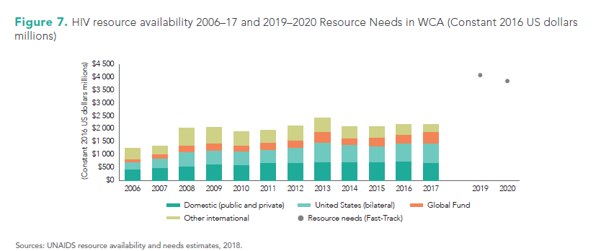
West and Central Africa funding gap
UNAIDS WCA report July 2018

Slide 23
Who will pay the price of premature transitions– the patients?
Notes:
Ultimately, we are worried that people in MIC and patients in particular will pay the price of graduation.
Now our concerns wider than MIC even, as shown in examples mentioned
How to reach SDGs in health when:
Countries face poor if any access to grants for health, increased reliance on loans
Restricted access to funding from Global health institutions (GHI) means reduced access to funding for essential medical commodities and human resources
No access to pooled procurement mechanisms (such as through GF),=> non-preferential prices for medicines and medical commodities etc..
Poorly guided domestic resource mobilization strategies instead leading to increase in user fees/out of pocket payments

